Slide 1



Property-based Testing of Embedded Systems
John Hughes

Slide 2
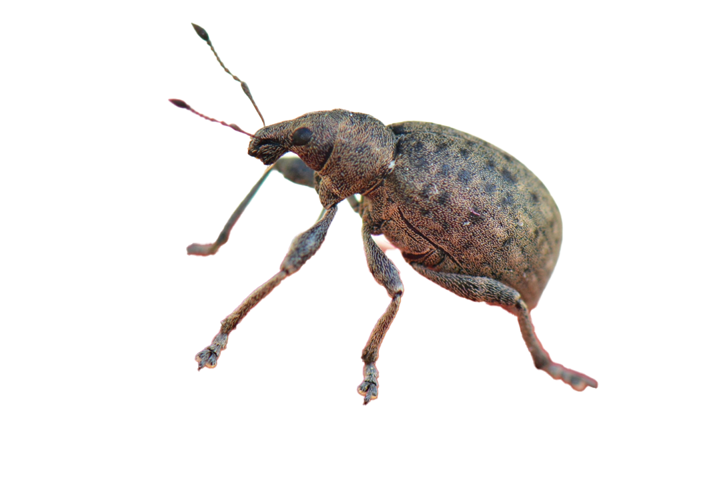
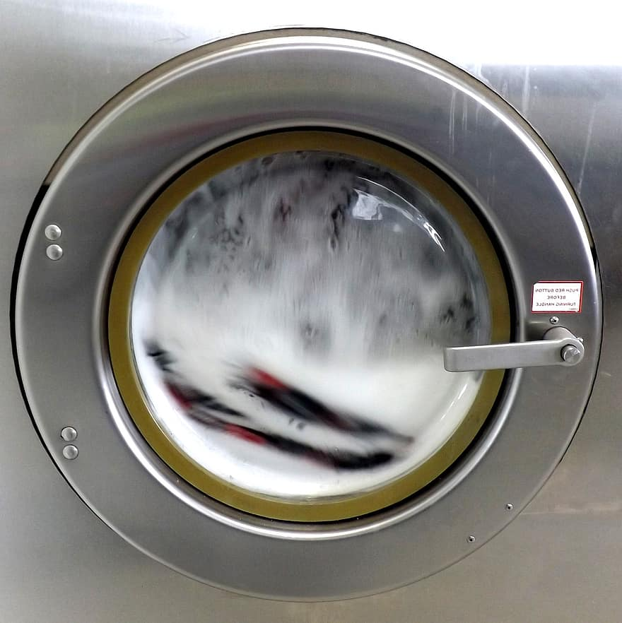
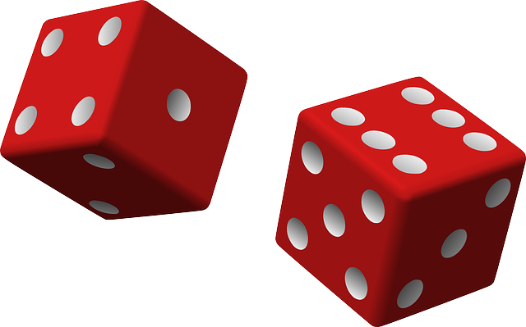
What is Property-based Testing?
Traditional automated testing
Test case
Expected results
Execution on SUT
Property-based testing
Test case generator
Property of results
Execution on SUT
Test oracle
Specification
QuickCheck
eqc
+ many others
Notes:
Random generation to provoke faults (often ones you wouldn’t think of)
Shrinking to diagnose faults; minimality ➔ relevance

Slide 3
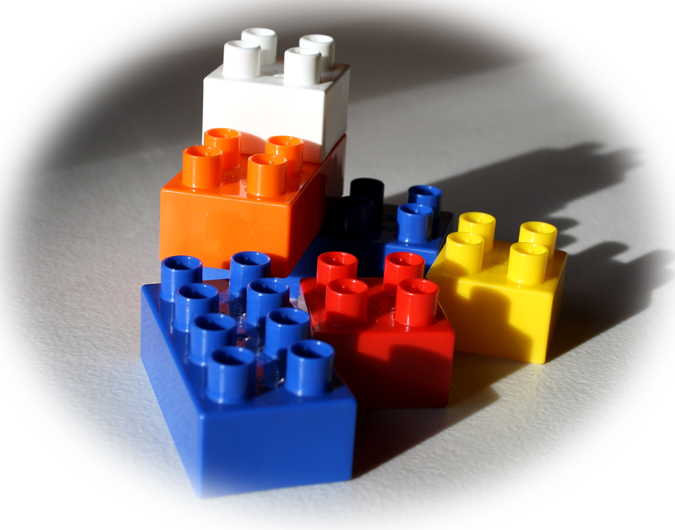

Systems with state
Example: circular buffer
+ q->size
Not modulo: remainder
int size(Queue *q)
{ return (q->inp - q->outp) % q -> size;
}
?
?
0 - 1 % 2
?
?
q:new(1) -> {ptr, "Queue", 1959398271824}
q:put({ptr, "Queue", 1959398271824}, 0) -> ok
q:get({ptr, "Queue", 1959398271824}) -> 0
q:put({ptr, "Queue", 1959398271824}, 0) -> ok
q:size({ptr, "Queue", 1959398271824}) -> -1
?
?
?
?
Notes:
Very general idea.
Key question: what is a test case?
Example: circular buffer implementing a queue
Note: minimal example presented, shrunk from test case of 36 steps

Slide 4
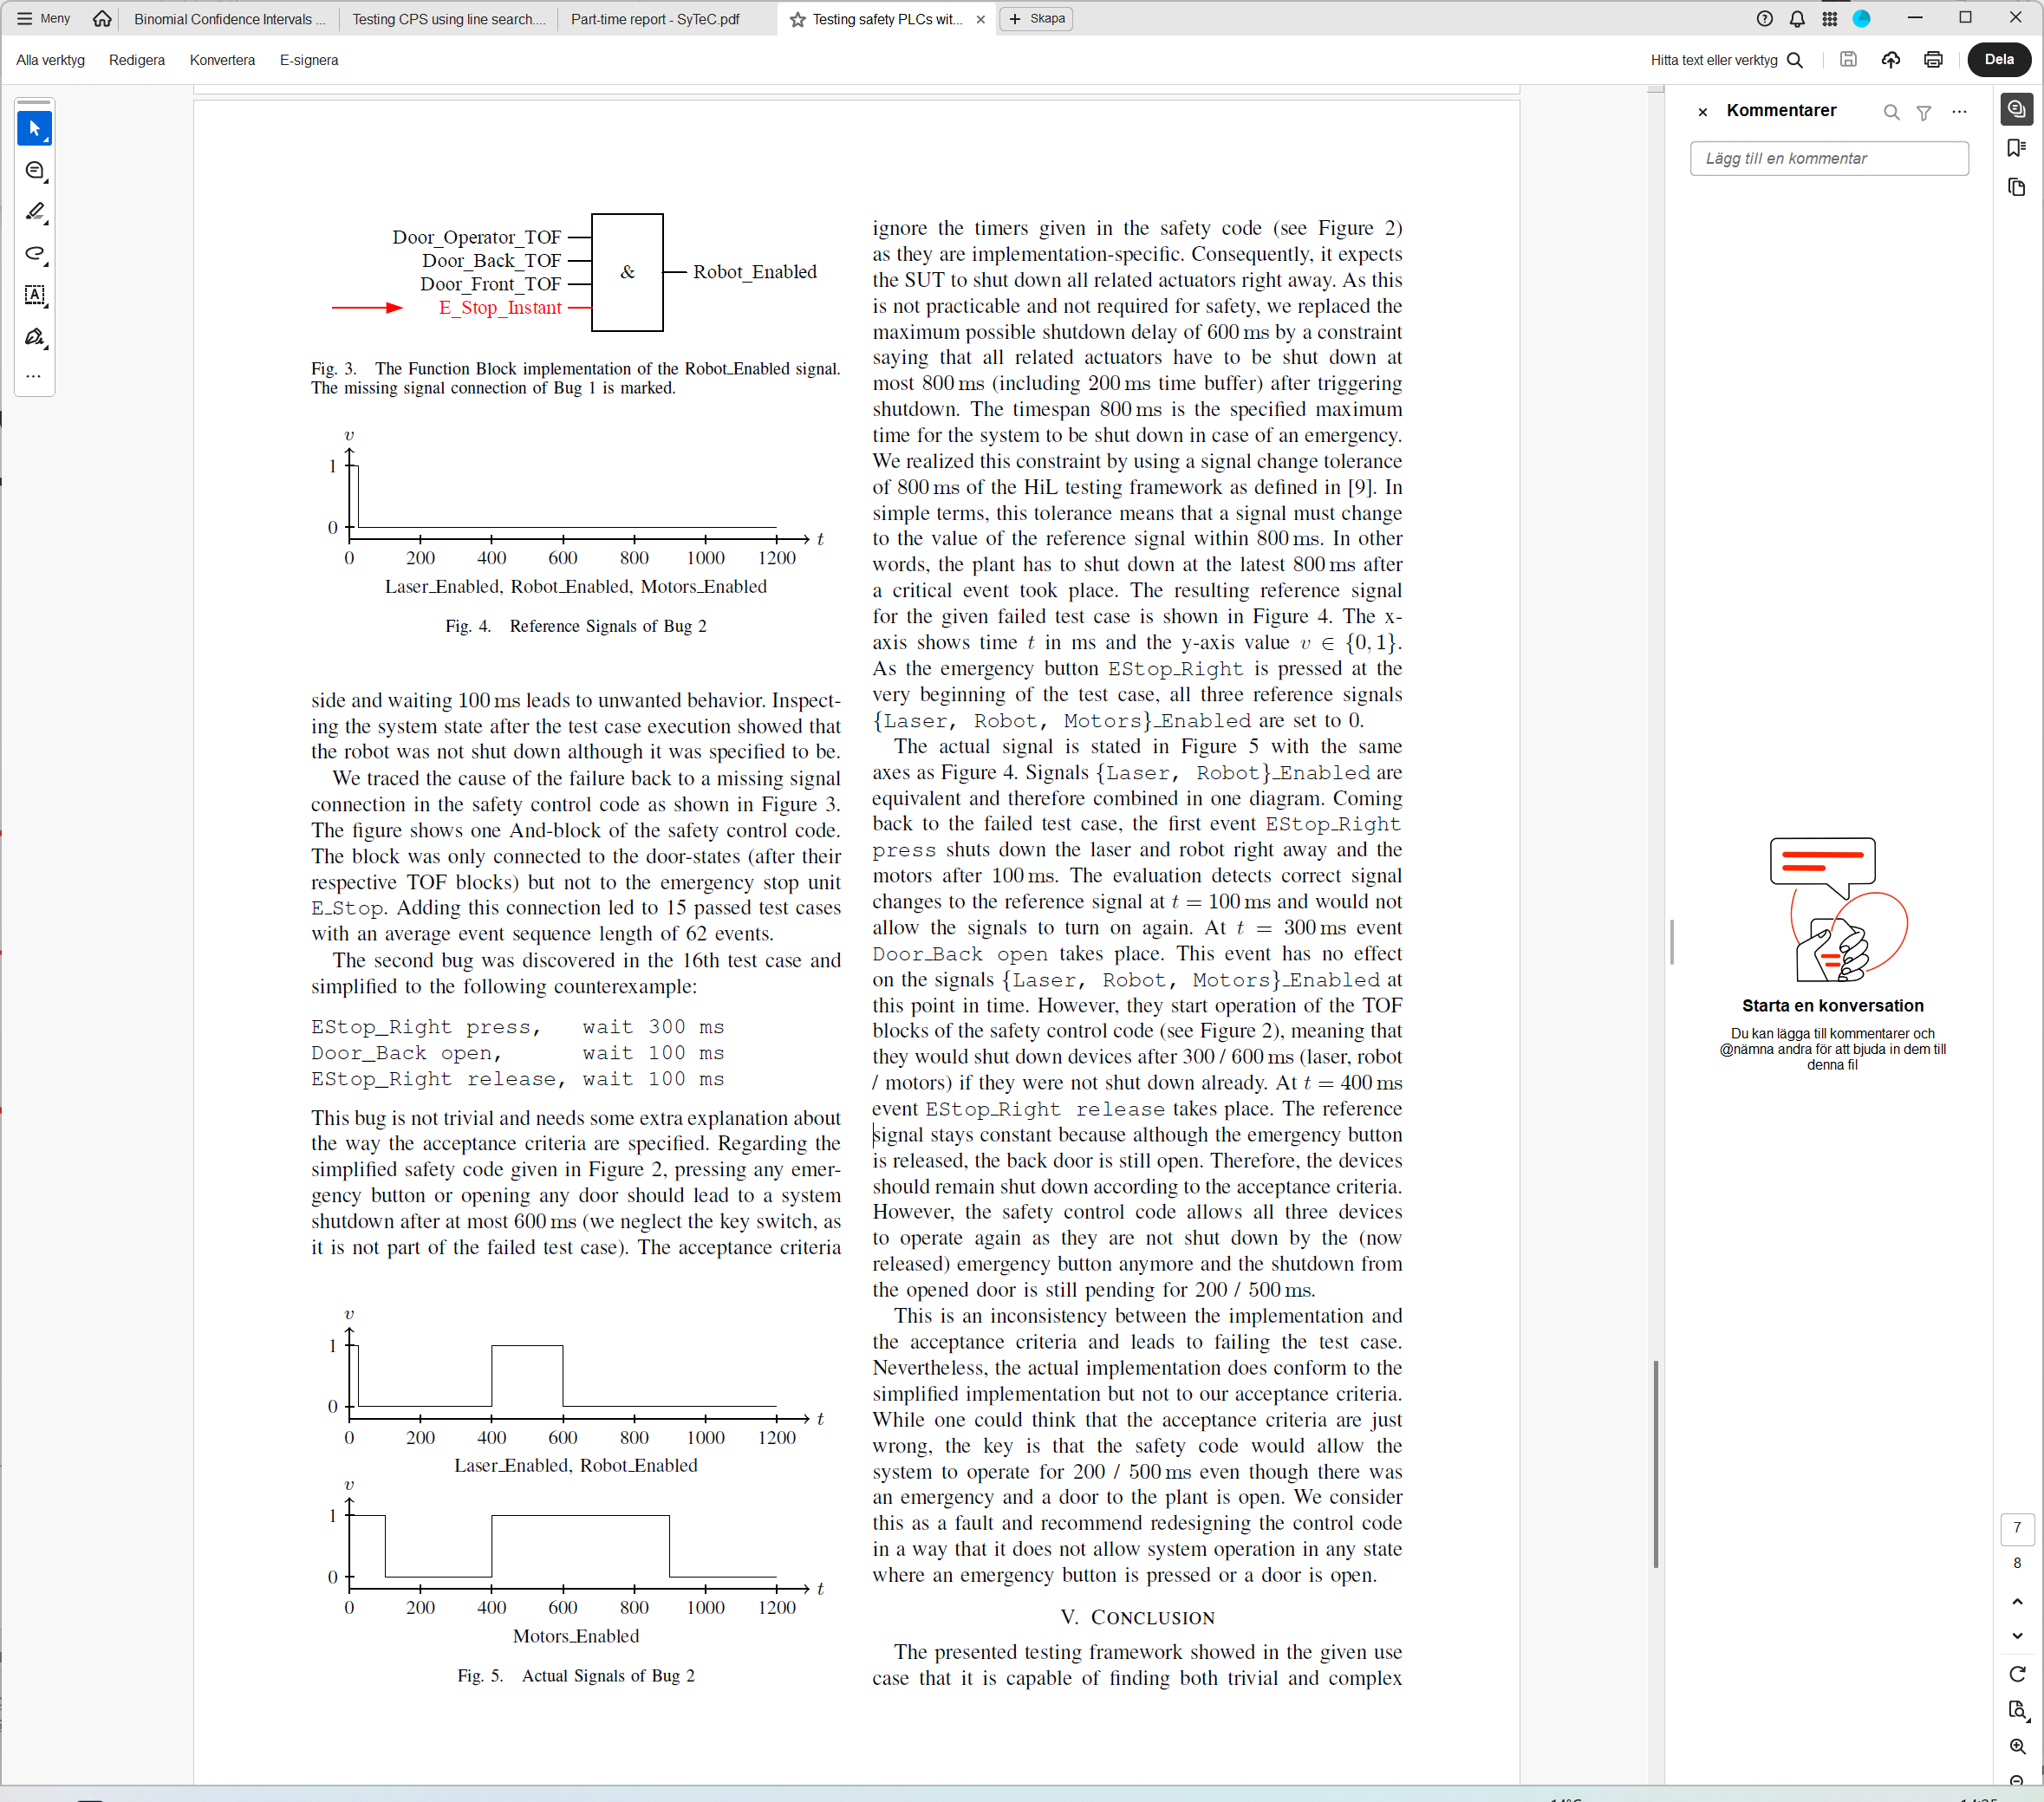
Testing Safety PLCs
SyTeC
Thonnessen, D., Smallbone, N., Fabian, M. et al (2019). Testing Safety PLCs Using QuickCheck. IEEE International Conference on Automation Science and Engineering, 2019
What is a test case?
Generate 0 ms half the time
Emergency stop buttons
Motors enabled
input 1 high, wait 500 ms
input 3 high, wait 200 ms
input 2 high, wait 800 ms
input 1 low, wait 200 ms
1000
Door sensors
Robot enabled
Generate transitions likely to stop the system much less often
EStop_Right press, wait 300 ms
Door_Back open, wait 100 ms
EStop_Right release, wait 100 ms
Laser enabled
Key (override) switch
Input and outputs:
Boolean signals, changing over time
Notes:
Contains logic and delays.
Safety for a robot with a laser in an enclosure; stop stuff in an emergency or if door is opened.
NOT random booleans at each instant—would not provoke behaviours like ”if button is pressed for 300ms…”
Shrinking adds delays when deleting a command; can also shrink delays.
On a release, the PC allows everything to be turned back on, despite the open door. Thanks to delays inside the PLC.

Slide 5
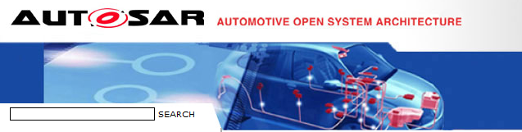

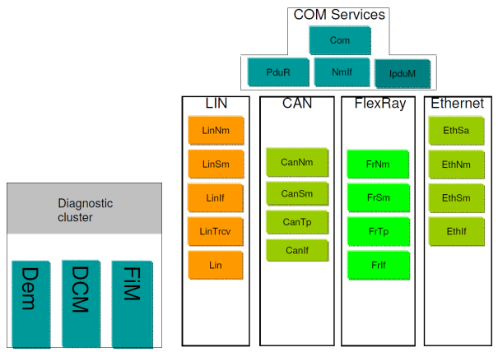
Notes:
Testing AutoSAR basic software
For Volvo Cars: Volvo buy components running basic software from different vendors; if they don’t follow the standard, they may not be able to talk to each other.

Slide 6
How do we model this?
Make top-level calls
Top-level API
CanNm
Check the expected calls are made
Provide return values—inputs to the component
Mock the lower level calls
Talks to the hardware driver
What is a test case step?
An API call, along with expected calls out
Notes:
How do we model this? Note each layer is specified separately; want to model one layer at a time.

Slide 7
How do we test using the models?
Generate a top-level call
Top-level calls
CanNm
Compute expected calls
Mock lower level calls
Use the model to compute results
Top-level calls
CanSm
Compute expected low-level calls
Mock lower level calls
Notes:
Implementation just a black box; does not consist of layers!
Clustering models means no implementation of the internal interface is needed.

Slide 8
A Bug in a vendor’s CAN stack
sending 1
send priority 1
CAN bus
send priority 2
queued
send priority 3
1 sent
sending 3
tx_confirm
Notes:
Feature interaction: you cannot test all combincations

Slide 9
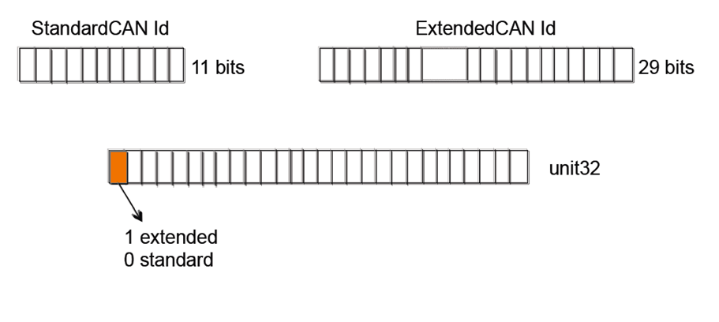
The Problem
CAN bus identifiers determine bus priority

Slide 10
A Bug in a vendor’s CAN stack
sending 1
send priority 1
CAN bus
send priority 2
queued
send priority 3
1 sent
sending 3
tx_confirm
Failed to mask off the top bit before comparing priorities
Notes:
Feature interaction: you cannot test all combincations

Slide 11
3,000 pages of specifications
20,000 lines of QuickCheck
1,000,000 LOC, 6 suppliers
200 problems
100 problems in the standard
Notes:
Does it scale? Yes, it scales.

Slide 12
Cyberphysical Systems
SyTeC
Ramezani, Z., Claessen, K., Smallbone, N. et al (2022). Testing Cyber-Physical Systems Using a Line-Search Falsification Method. IEEE Transactions on Computer-Aided Design of Integrated Circuits and Systems, 41(8)
Combination of discrete and continuous behaviour
Example: adaptive cruise control
  Speed/distance/gas/brake: continuous
  Hitting the car in front: discrete
Running a test ➔ running a simulation: expensive
What is a test case?
Arbitrary data + N real parameters (e.g. wavelength, amplitude…)
Sometimes random generation is not enough

Slide 13
Example: Distance to car in front
Optimisation
PASS
PASS
FAIL
Distance to False:
5
0,5
0

Slide 14
”Valued Booleans”
(True, 5)
distance to False
(True,d₁) && (True,d₂) = (True, 1 )
1
+
1
d₁
d₂
(True, 5) && (True, 0.5) = (True, ⁴⁵/₉₉)
(True, 4) && (True, 0.5) = (True, ⁴⁴/₉₉)
(True, 5) && (True, 0.4) = (True, ³⁷⁰/₉₉₉)

Slide 15
”Line Search”
Search for a zero:
In R^{N}, switch now and then to a line in a random direction through the current point

Slide 16
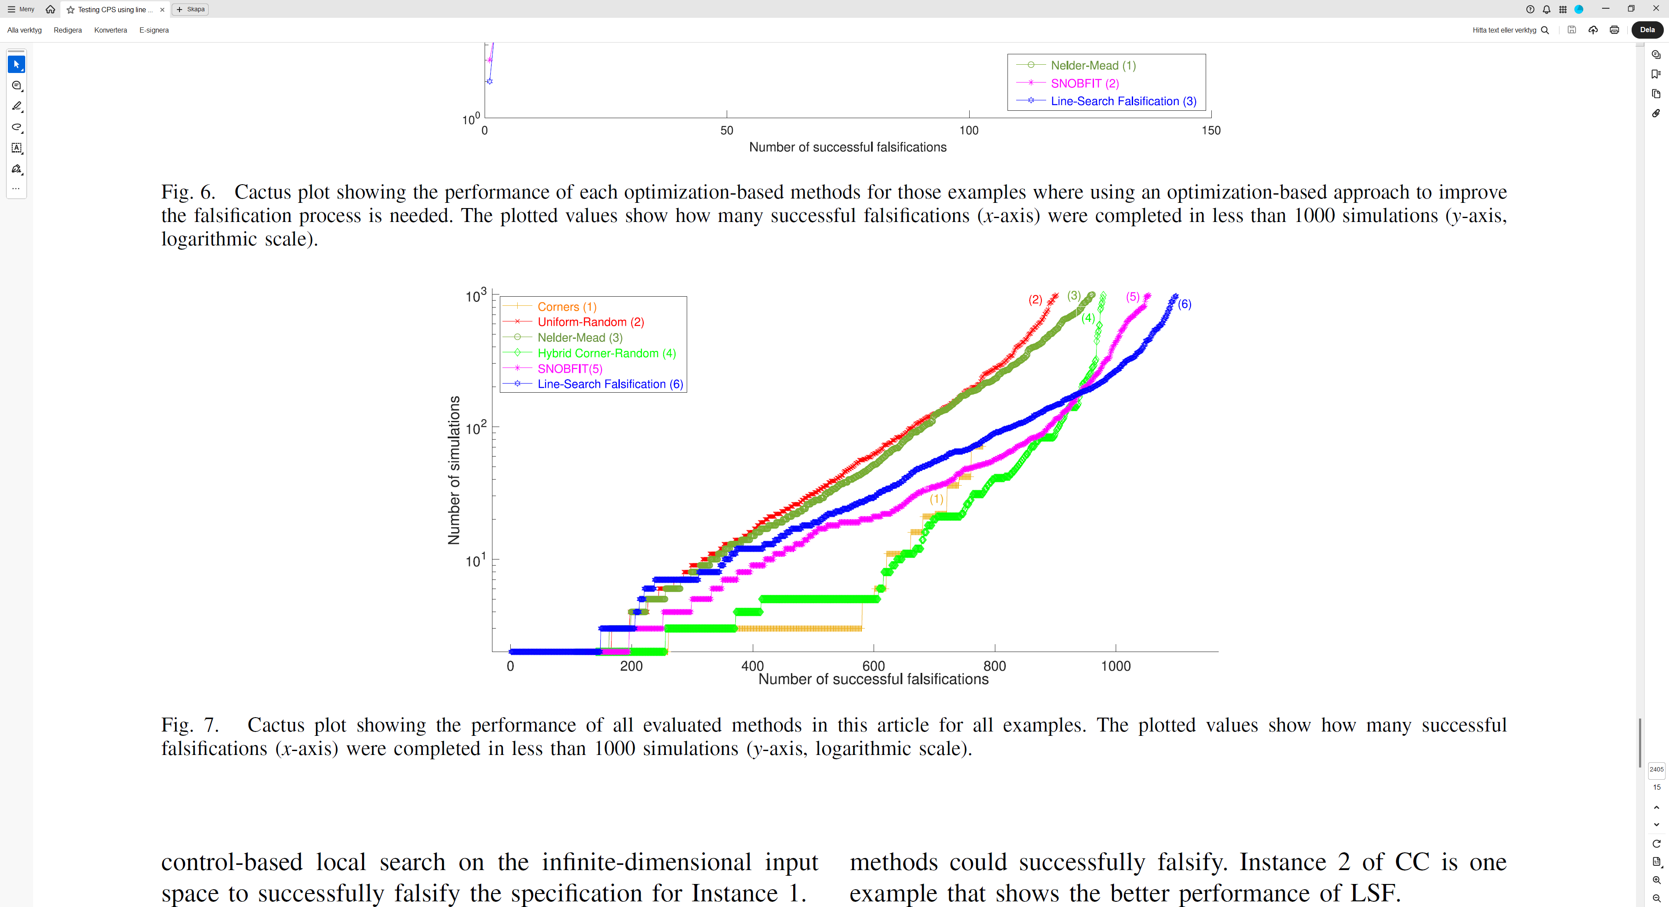
Notes:
Uniform random is the worst… but solves some examples well.
Hybrid corner-random (uniform half the time, extremal values half the time) works surprisingly well for easy examples
* Beyond about 200 simulations (i.e. for harder examples), line-search is överlägset.

Slide 17
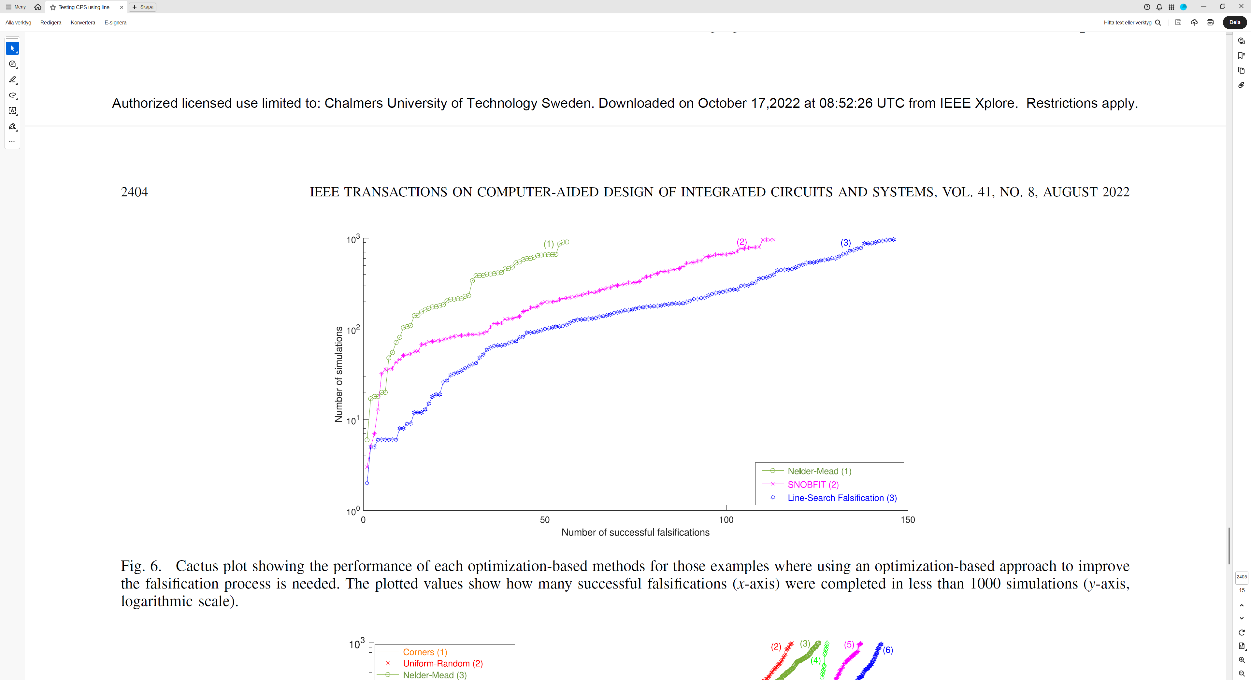
Notes:
If we confine our attention to those problems where optimisation is needed to find a counterexample: LSF looks even better.

Slide 18
Three settings for PBT of embedded systems
Exploit a specification without any proofs
What is a test case?
How to generate, shrink, or optimise them
Finds failing tests you would never have thought of
Notes:
We’ve seen PBT in three settings.
What can we learn?

Slide 19
Don’t write tests
Generate them!

